Slide 1
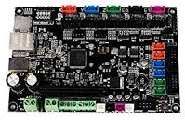
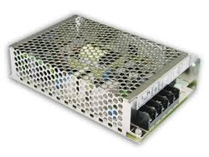
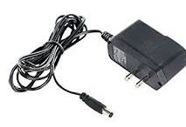
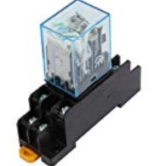
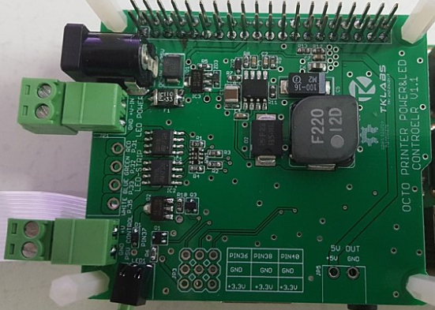

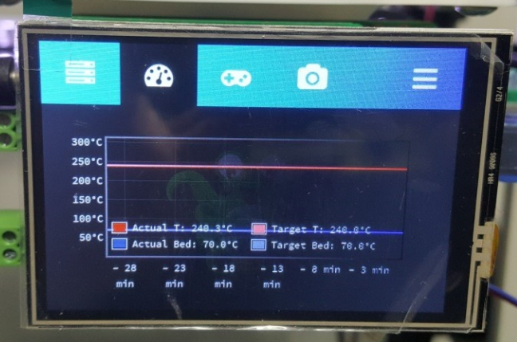
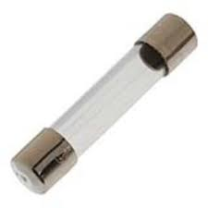
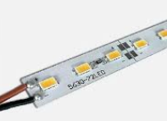
MAIN SWITCHING POWER SUPPLY
SMPS DC12 or DC 24V OUT
3D PRINTER CONTROLER
SMPS
DC12 or DC24V
ADAPTER
(1Ah OVER)
AC ADAPTER
EARTH WIRE
AC POWER OUT
DC12V or DC24V
RELAY
1
4
Raspberry Pi
OCTO Printer HAT
5
8
POWER SWITCH
(OPTION)
9
12
13
14
AC POWER INPUT
EXTERNAL
RELAY CONTROL OUT
(DC12 or DC24V)
AC FUSE
LED LAMP
(OPTION)

Slide 2
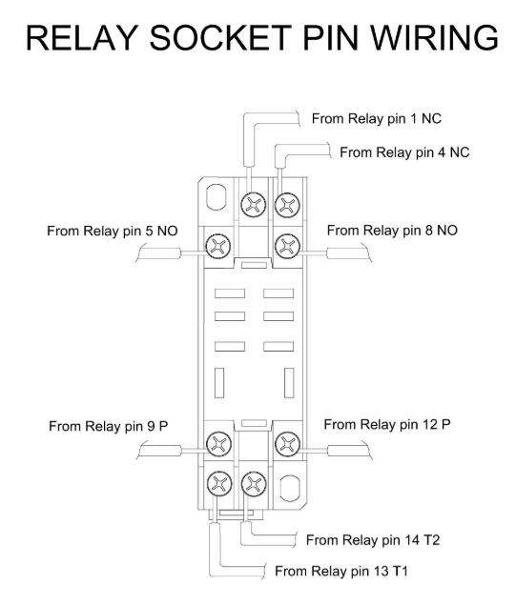
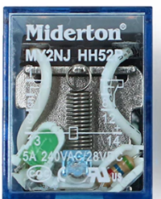
AC POWER OUT
(PSU UNIT)
AC POWER OUT
(PUS UNIT)
AC POWER IN
NETURAL
AC POWER IN
LIVE
+12 or 24V
(OCTO-PSU +OUT)
GND
(OCTO PI-PSU GND)
+12 or 24V

